Slide 1
Why does performance at scale need to be put alongside functional accuracy?

Slide 2
2^n =?
while (n > 0) {
if ((n % 2) == 1) {
result *= x;
}
x *= x;
n /= 2;
}
public static int powerOfTwo(int n) {
return 1 << n;
}
public double power(double x, int n) {
double result = 1.0;
if (n == 0) return 1;
// If the exponent is negative, convert the base and exponent
if (n < 0) {
x = 1 / x;
n = -n;
}
for (int i = 0; i < n; i++) {
result *= x;
}
return result;
}
Exponentiation by Squaring O(logn)
Bit shift O(1)
O(n)

Slide 3
2^n =?
while (n > 0) {
if ((n % 2) == 1) {
result *= x;
}
x *= x;
n /= 2;
}
public static int powerOfTwo(int n) {
return 1 << n;
}
public double power(double x, int n) {
double result = 1.0;
if (n == 0) return 1;
// If the exponent is negative, convert the base and exponent
if (n < 0) {
x = 1 / x;
n = -n;
}
for (int i = 0; i < n; i++) {
result *= x;
}
return result;
}
Exponentiation by Squaring O(logn)
Bit shift O(1)
O(n)

Slide 4
2^n =?
while (n > 0) {
if ((n % 2) == 1) {
result *= x;
}
x *= x;
n /= 2;
}
public static int powerOfTwo(int n) {
return 1 << n;
}
public double power(double x, int n) {
double result = 1.0;
if (n == 0) return 1;
// If the exponent is negative, convert the base and exponent
if (n < 0) {
x = 1 / x;
n = -n;
}
for (int i = 0; i < n; i++) {
result *= x;
}
return result;
}
O(n)
Exponentiation by Squaring O(logn)
Bit shift O(1)

Slide 5
2^n =?
public static int powerOfTwo(int n) {
return 1 << n;
}
public double power(double x, int n) {
double result = 1.0;
if (n == 0) return 1;
// If the exponent is negative, convert the base and exponent
if (n < 0) {
x = 1 / x;
n = -n;
}
for (int i = 0; i < n; i++) {
result *= x;
}
return result;
}
while (n > 0) {
if ((n % 2) == 1) {
result *= x;
}
x *= x;
n /= 2;
}
O(n)
Exponentiation by Squaring O(logn)
Bit shift O(1)

Slide 6
2^n =?
public static int powerOfTwo(int n) {
return 1 << n;
}
public double power(double x, int n) {
double result = 1.0;
if (n == 0) return 1;
// If the exponent is negative, convert the base and exponent
if (n < 0) {
x = 1 / x;
n = -n;
}
for (int i = 0; i < n; i++) {
result *= x;
}
return result;
}
while (n > 0) {
if ((n % 2) == 1) {
result *= x;
}
x *= x;
n /= 2;
}
O(n)
Exponentiation by Squaring O(logn)
Bit shift O(1)

Slide 7
2^n =?
public double power(double x, int n) {
double result = 1.0;
if (n == 0) return 1;
// If the exponent is negative, convert the base and exponent
if (n < 0) {
x = 1 / x;
n = -n;
}
for (int i = 0; i < n; i++) {
result *= x;
}
return result;
}
while (n > 0) {
if ((n % 2) == 1) {
result *= x;
}
x *= x;
n /= 2;
}
public static int powerOfTwo(int n) {
return 1 << n;
}
O(n)
Exponentiation by Squaring O(logn)
Bit shift O(1)

Slide 8
2^n =?
public double power(double x, int n) {
double result = 1.0;
if (n == 0) return 1;
// If the exponent is negative, convert the base and exponent
if (n < 0) {
x = 1 / x;
n = -n;
}
for (int i = 0; i < n; i++) {
result *= x;
}
return result;
}
while (n > 0) {
if ((n % 2) == 1) {
result *= x;
}
x *= x;
n /= 2;
}
public int powerOfTwo(int n) {
return 1 << n;
}
O(n)
Exponentiation by Squaring O(logn)
Bit shift O(1)

Slide 9
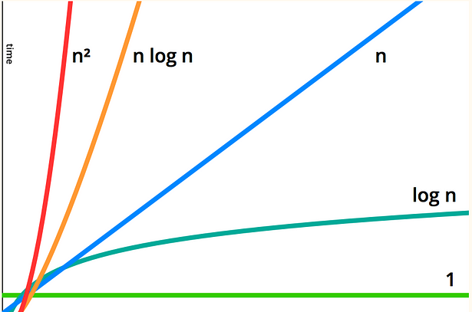
Compare

Slide 10

Sumon Mal
Head of Backend Engineering

Slide 11
Omni Channel Communications @ Travel Domain (2018 – 2020)
A scalable campaign manager can handle the transaction and burst traffic.
80 Million + daily communication over 3 different channels

Slide 12
How did we solve it
Re-build it as a platform, by building platform capabilities
Created priority traffic and normal traffic channels
Introduced a rule engine to select the best one for the customer
Kafka, Redis being the savior
Elastic search was our Recommendation engine
Problem with the previous system
It’s been a group of microservices to interface comms partners
Traffic congestion occurred frequently due to burst load
Customers received multiple communications

Slide 13
Order Optimizer @ Retail Domain (2020 – 2023)
Fresh development, Cloud-native to matchup Mainframe computation.
A stateful service to solve combinatorial problem statement.
27 Million data optimization in 17 mins
Lower functional accuracy or missing SLA could lead to ££ Million losses < 20M£

Slide 14
How did we solve it
In-depth of Kafka stream, modified stream processors
POC over stream, In memory computation, Database RW
Test bed setup for load generator, and perf test on demand.
Take the hard call and get in-memory computation in place.
Build retrigger API to reprocess as part of resilient execution
Our first failure
The first model, 3 Million data processing failed endurance after 5 hours
Functional accuracy improved but too far from the performance mark.
Kafka Stream was the bottleneck

Slide 15
Lending @ Fintech Domain (2023 – 2024)
Loan readiness TAT improved by 63%
What was the bottle neck
Single consumer service was responsible for e2e flow.
Orchestration model and serial processing was not scalable
How did we improve it
Switched to parallel processing
Collate all parameters ^{steps} at the end for decision - making
^{steps} Loan onboarding, Disbursement, Fraud, Closure, Docs

Slide 16
Streaming @ Media
Sports events at a global scale
CDN – Data localization
Cascading Cache

Slide 17
Travel
Fintech
Code level optimization
In-memory computation
Parallel processing
Caching
Indexing
Data localization
Streaming
Retail

Slide 18
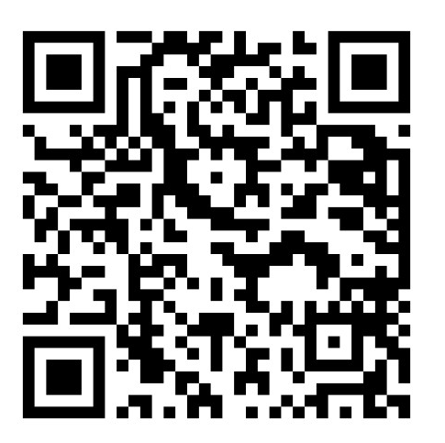
Sumon Mal
Head of Backend Engineering
linkedin.com/in/sumonmal

